Slide 1
RESEARCH PROPOSAL · REINFORCEMENT LEARNING × ROBOTICS
Physics-Informed Adaptive Reward Generation for Sim-to-Real Dexterous Hand Control
Amartya Ranjan (23BRS1309), Rajarshi Somvanshi (23BRS1171), Aditya Kumar Singh (23BRS1356) · SCOPE, Vellore Institute of Technology, Chennai
Dr. Saranya M (SCOPE) · Month 2026
LLM reward generation
Adaptive domain randomization
PINN failure diagnosis
Shadow Hand + LEAP Hand

Slide 2
02 · INTRODUCTION
Why automate reward design for dexterous hands?
Reward engineering is the bottleneck of RL — hand-tuned rewards need expert effort, and poor rewards silently cap policy quality.
Eureka [1]: a coding LLM writes reward functions from raw environment source code, refined by evolutionary search + reward reflection.
DrEureka [2]: extends this by LLM-generating domain randomization (DR) configs → zero-shot sim-to-real transfer.
Dexterous in-hand manipulation is the hardest testbed: high DOF (16–20 actuated joints), continuous multi-point contact, severe sim-to-real gap.
Training uses PPO [3] in massively parallel GPU simulation (Isaac Gym [10]) — thousands of environments per GPU.
Our aim: make the reward–DR loop self-diagnosing and adaptive, so it converges to rewards that transfer, not just rewards that score.
02 / 12

Slide 3
03 · PROBLEM STATEMENT
The reward loop is blind to physics
P1
Static DR DrEureka fixes DR ranges once, before training; policy robustness evolves, ranges don't (named a limitation by the authors themselves [2]).
P2
No failure attribution Reward reflection reports that a reward failed, never why: reward-logic bug vs. physics/dynamics mismatch look identical to the LLM.
P3
Risk of reward shunting An unconstrained LLM “fixes” physics errors inside reward code, masking the true cause and hurting transfer.
P4
Lossy feedback channel Hand-crafted per-component scalar statistics discard where and how trajectories fail.
Formal statement
Given task spec ℓ and environment M, jointly search reward R and DR distribution φ such that a PPO policy trained on (Mφ, R) maximizes true task fitness F on the real / held-out system — with failure feedback that separates physical mismatch from reward-logic error.
03 / 12

Slide 4
04 · LITERATURE SURVEY
Where prior work stands
Work | Approach | Limitation w.r.t. this project
Eureka [1] | LLM reward code + evolutionary search + reward reflection; 29 tasks incl. Shadow Hand pen spinning | Sim-only; no DR; reflection is hand-crafted statistics
DrEureka [2] | LLM-generated DR via reward-aware physics prior; zero-shot real transfer (Go1, LEAP Hand) | DR static after generation; no physics diagnosis
ADR [5] | Auto-widening DR ranges from policy performance (Rubik's cube) | Hand-designed reward; not coupled to any reward loop
REvolve [6] | LLM rewards with true evolutionary operators + human-feedback fitness | Needs humans in loop; no DR, no physics signal
PIN-WM [7] | Physics-informed world model; DR as “digital cousins” around identified params | Non-prehensile pushing; no LLM rewards
PI-DDPG [8] | PINN-in-the-loop RL control of a 4-DOF manipulator | Fixed hand-designed reward; low DOF; no sim-to-real DR
Surveys [11],[12] | Taxonomies of sim-to-real: DR, adaptation, system ID, LLM-based reward design | Confirm no unified adaptive-DR + physics-diagnosis loop exists
04 / 12

Slide 5
05 · RESEARCH GAPS
Four gaps at the intersection
G1
DR never adapts inside the LLM loop
G2
No physics-failure attribution
ADR [5] adapts but has no LLM rewards; DrEureka [2] has LLM rewards but static DR. No work couples both to one feedback channel.
PINNs model manipulator dynamics [4],[8] — never used to tell an LLM why a reward fails.
G3
Attribution never validated
G4
Feedback channel is hand-crafted; single morphology
No prior protocol tests a diagnosis signal against injected ground-truth faults (known reward bugs vs. known dynamics shifts).
Reflection statistics are fixed heuristics, not learned. Reward-generation systems rarely validated across two hand morphologies.
05 / 12

Slide 6
06 · CONTRIBUTIONS
What this work adds
C1
Adaptive DR in the reward loop — ranges widen/narrow every N reward iterations from policy performance, driven by the same feedback channel that edits rewards. (closes G1)
C2
PINN failure diagnosis with routing — physics-residual signal classifies failures; reward-logic → reward edit only, physics mismatch → DR update only. Reward code is barred from absorbing physics errors. (closes G2)
C3
Injection-validated attribution — known reward bugs vs. known dynamics perturbations give a ground-truth AUC for the diagnosis signal, plus shuffled-signal placebo arms. (closes G3)
C4
Learned failure-mode summarizer — MLP trained to predict episode outcome + failure phase replaces hand-crafted reflection statistics. (closes G4, optional rung)
Eval
Cross-morphology ablation — full 4-rung ladder on Shadow Hand (20 DOF, sim suite) and LEAP Hand (16 DOF, sim + real hardware); one component changes per rung.
06 / 12

Slide 7
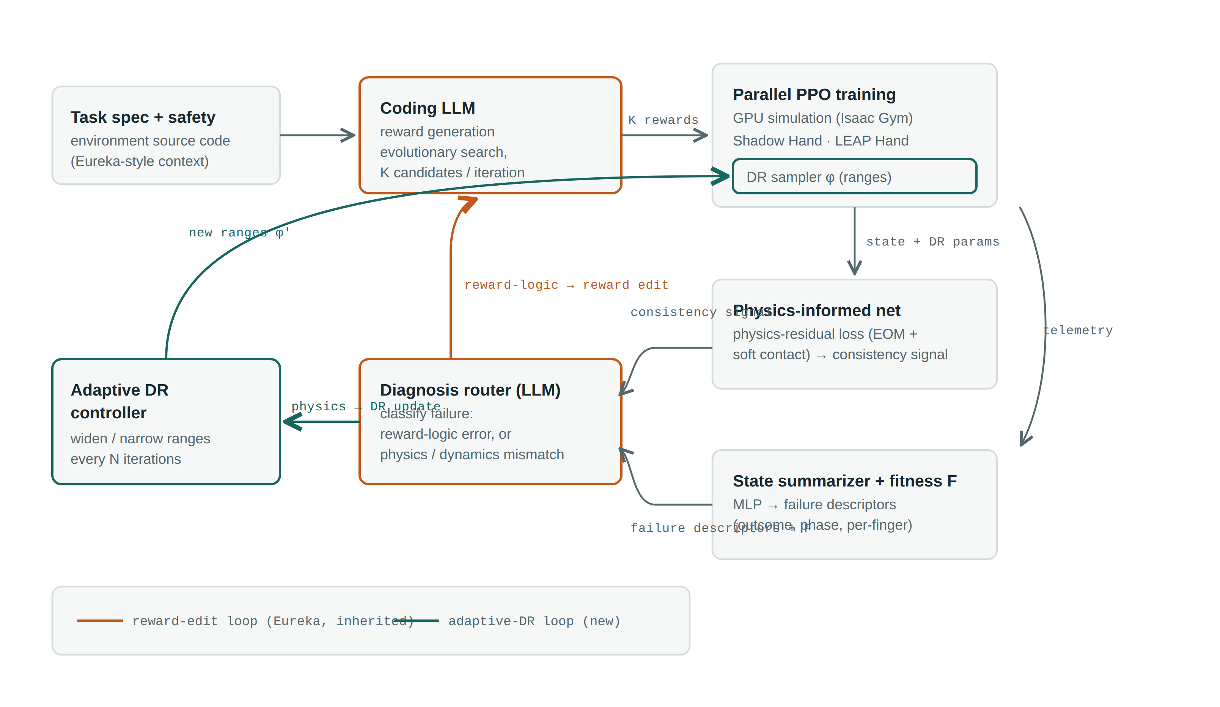
07 · ARCHITECTURE (ABSTRACT)
Two feedback loops, one diagnosis router
07 / 12
Router rule: each diagnosis can trigger only its own loop — reward code never compensates for physics mismatch.

Slide 8
08 · MODULE SPLIT
Five modules, mapped to contributions
M1
(inherited)
M2
(C1)
M3
(C2, C3)
Reward generation loop
Adaptive DR controller
PINN + diagnosis router
Eureka pipeline unmodified: LLM → K candidates → parallel PPO → reflection. Kept as-is for ablation validity (rung 1).
Performance-thresholded widen/narrow of DR ranges every N iterations. Initialized from DrEureka's reward-aware physics prior.
MLP; supervised loss + physics residual (Lagrangian EOM, relaxed contact). Contact-gated diagnostic signal; two-stage routing prompt; pre-trained frozen first.
M4
(C4, optional)
M5
Failure-mode summarizer
Evaluation & transfer harness
Trained on free labels: episode success + hindsight failure phase. Descriptors join the reflection channel; cuttable without breaking M1–M3.
4-rung ablation ladder × 2 morphologies. Injection calibration, placebo arms, routing audit. Real LEAP Hand deployment; held-out “pseudo-real” sim for Shadow Hand.
08 / 12

Slide 9
09 · DATASET DESCRIPTION
Simulation-generated data, four corpora
No fixed offline dataset — all training data is generated online by GPU-parallel simulation (~4,096 environments per run, native control rate ≈ 60 Hz).
Environments — Shadow Hand [1],[10]: 24 joints / 20 actuated; Eureka's 29-task suite. LEAP Hand [2],[9]: 16 DOF; in-hand cube rotation; observations = 16 joint angles + proprioceptive history only (no object pose).
Rollout telemetry (per step): joint positions/velocities/torques, tracking error, contact events, active DR parameter values — feeds reflection + summarizer.
PINN corpus: privileged sim transitions — hand joint state + object 6-DoF pose/twist + DR params — sampled across DR ranges; physics residual is self-supervised (no manual labels).
Summarizer corpus: episodes auto-labeled success/failure by fitness F, plus hindsight failure-phase windows.
Injection corpus (ground truth for validation): labeled runs with seeded reward bugs (sign flip, wrong scale, missing term) vs. seeded dynamics shifts (mass ×1.5, friction ×0.3, added damping).
Real-world eval set: physical LEAP Hand rollouts — rotations per 20 s episode, zero-shot.
09 / 12

Slide 10
10 · PERFORMANCE METRICS
Every claim gets its own number
Claim under test | Metric | Protocol
Reward quality | Task fitness F: consecutive successes (reorientation); rotations / 20 s (LEAP); human-normalized improvement | Eureka scoring, unchanged [1]
Sim-to-real transfer | Zero-shot success rate + rotations on physical LEAP Hand | DrEureka deployment protocol [2]
Sim-to-OOD-sim transfer | Fitness on held-out perturbed sim config (outside all DR ranges) | Shadow Hand; config hidden from whole loop
Diagnosis validity | AUC: reward-bug vs. dynamics-shift discrimination | Injection calibration study
Routing quality | Diagnosis→edit confusion matrix accuracy | Routing audit vs. injected ground truth
Signal is load-bearing | Δ fitness: real vs. shuffled vs. no signal | Placebo arms (2×2 at rung 4)
Efficiency | Reward iterations-to-threshold; wall-clock per rung | Identical budgets across rungs
10 / 12

Slide 11
11 · CONCLUSION
Takeaways
Extends Eureka/DrEureka precisely where its authors flagged limits: static DR → adaptive, blind reflection → physics-attributed diagnosis.
The routing rule is the key safeguard — reward edits fix reward logic, DR updates fix physics, so the PINN's contribution stays measurable.
Validation is built in, not bolted on: injection ground truth, placebo arms, one-component-per-rung ablation, replicated across two hand morphologies.
Deliverables: adaptive reward-generation pipeline, validated diagnosis protocol (reusable beyond this system), zero-shot real LEAP Hand transfer results.
Future work: vision-based observations, online PINN retraining, extension to bimanual and deformable-object manipulation.
Immediate next milestones
Rung-1 reproduction on both platforms → injection calibration study (go/no-go for the PINN pillar) → LEAP Hand hardware build in parallel.
11 / 12

Slide 12
12 · REFERENCES (IEEE)
References
[1] Y. J. Ma et al., “Eureka: Human-level reward design via coding large language models,” in Proc. ICLR, Vienna, Austria, 2024.
[2] Y. J. Ma et al., “DrEureka: Language model guided sim-to-real transfer,” in Proc. RSS, Delft, Netherlands, 2024.
[3] J. Schulman et al., “Proximal policy optimization algorithms,” arXiv:1707.06347, 2017.
[4] M. Raissi, P. Perdikaris, and G. E. Karniadakis, “Physics-informed neural networks,” J. Comput. Phys., vol. 378, pp. 686–707, 2019.
[5] I. Akkaya et al., “Solving Rubik's cube with a robot hand,” arXiv:1910.07113, 2019.
[6] R. Hazra et al., “REvolve: Reward evolution with LLMs using human feedback,” arXiv:2406.01309, 2025.
[7] W. Li et al., “PIN-WM: Physics-informed world models for non-prehensile manipulation,” arXiv:2504.16693, 2025.
[8] R. Fareh et al., “Physics-informed reward shaped RL control of a robot manipulator,” Ain Shams Eng. J., vol. 16, 2025.
[9] K. Shaw, A. Agarwal, and D. Pathak, “LEAP Hand: Low-cost, anthropomorphic hand for robot learning,” in Proc. RSS, Daegu, South Korea, 2023.
[10] V. Makoviychuk et al., “Isaac Gym: GPU-based physics simulation for robot learning,” in Proc. NeurIPS Datasets and Benchmarks, 2021.
[11] L. Da et al., “A survey of sim-to-real methods in RL,” arXiv:2502.13187, 2025.
[12] A. Pitkevich and I. Makarov, “A survey on sim-to-real transfer for robotic manipulation,” in Proc. IEEE SISY, 2024.
[13] J. Deng, Y. Dong, and Z. Liu, “Reward shaping in RL for robotic hand manipulation,” Neurocomputing, vol. 638, 2025.
12 / 12

